Slide 1
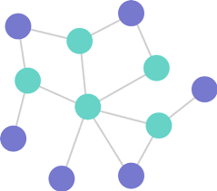
Graphs and Their Algorithms
Focusing on Python and C++ Implementations
Joshua Ganschow – Dakota State University
10/29/24

